Slide 1
HOTEL MANAGEMENT SYSTEM
Asharib Ahmed-CSC-18F-096
Mahnoor Anwar-CSC-18F-067
Danella Patrick-CSC-18F-169
Rabiya Tariq -CSC-18F-100
Urwa Maqsood -CSC-18F-158

Slide 2
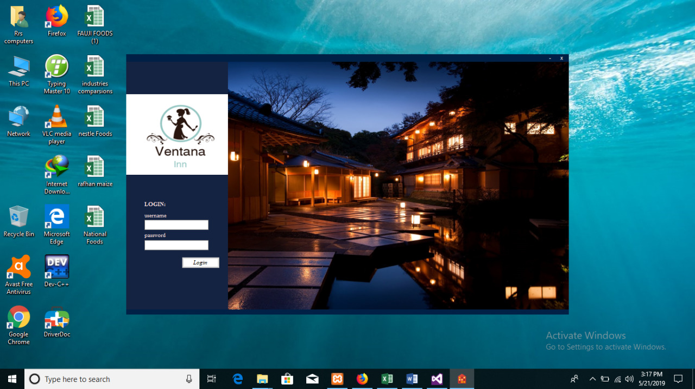
Welcome to Ventana Inn

Slide 3

Hotel Management System:
Table of Content
Introduction
Features of our Program
Advantages of our Project
Project Overview
Tools/ Software
Future Scope of our application
Conclusion

Slide 4
Introduction:
“HOTEL MANAGEMENT SYSTEM” is software developed for managing various activities in the hotel. For the past few years the number of hotels are increasing and there is a lot of stress on the owner and the employees of the hotel to overcome such problems many software are developing. Hotel management system particularly deals with the problems on managing a hotel and avoids the problems which occur when carried manually. We can improve the efficiency of the system with the help of hotel management.

Slide 5
Features of our Program:
Separate Login for both kitchen & reservation table
Universal Search field where you can search using any data type
Add/edit/update/delete an entry
Room Availability & Reservation
Credit card & Debit card verification
Reservation with complete details
Overview of Reservations from all hotel rooms in data gridview

Slide 6
Advantages of Ventana Inn
Performance
Efficiency
Control

Slide 7
PROJECT OVERVIEW
Simplify the large volume of data
View activity details directly and easily.
Compare information from different activities.
Gain time in managing your work.
Access project activities quickly and easily.
Control and monitor the our hotel easily.

Slide 8
Tools & Softwares
Label
DataGrid View
ComboBox
Button
Picture Box
Panel
Date time Picker
Text box
Group

Slide 9




SOFTWARE
Visual Basic
Xampp
Firefox
MY SQL
This Photo by Unknown Author is licensed under CC BY-SA

Slide 10
Database At Reservation:
Variable | Data type | Length
Name | Varchar | 100
Father name | Varchar | 100
Birthday | Varchar | 100
Gender | Char | 100
Email | Varchar | 100
Address | Varchar | 100
City | Varchar | 100
Zip Code | Varchar | 100
Entry date | Int | 100
Departure date | Int | 100
ID | Varchar | 100
Phone number | Int | 100

Slide 11
Outputs:

Slide 12
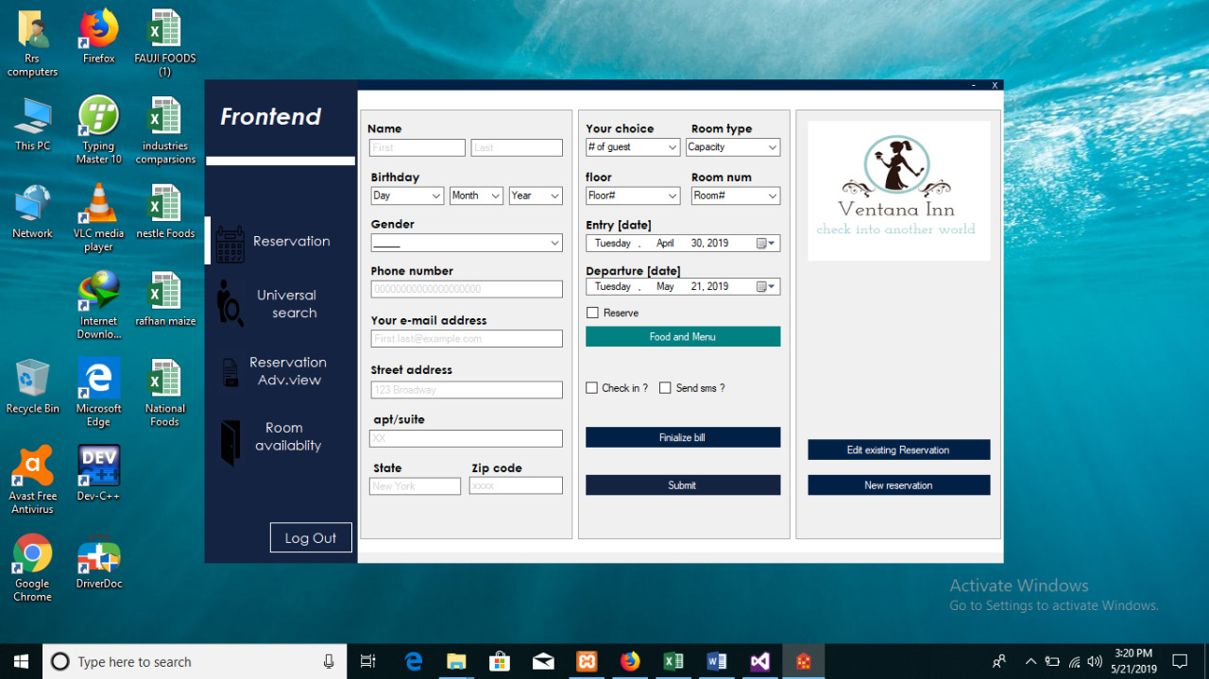

Slide 13
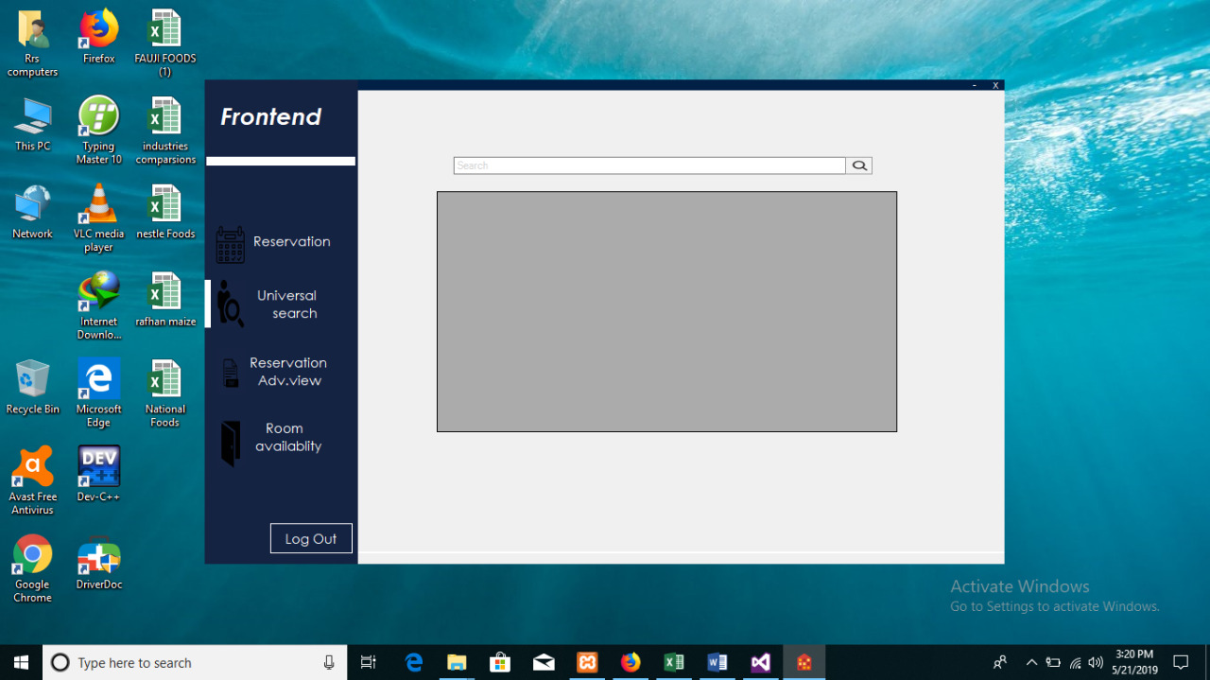

Slide 14
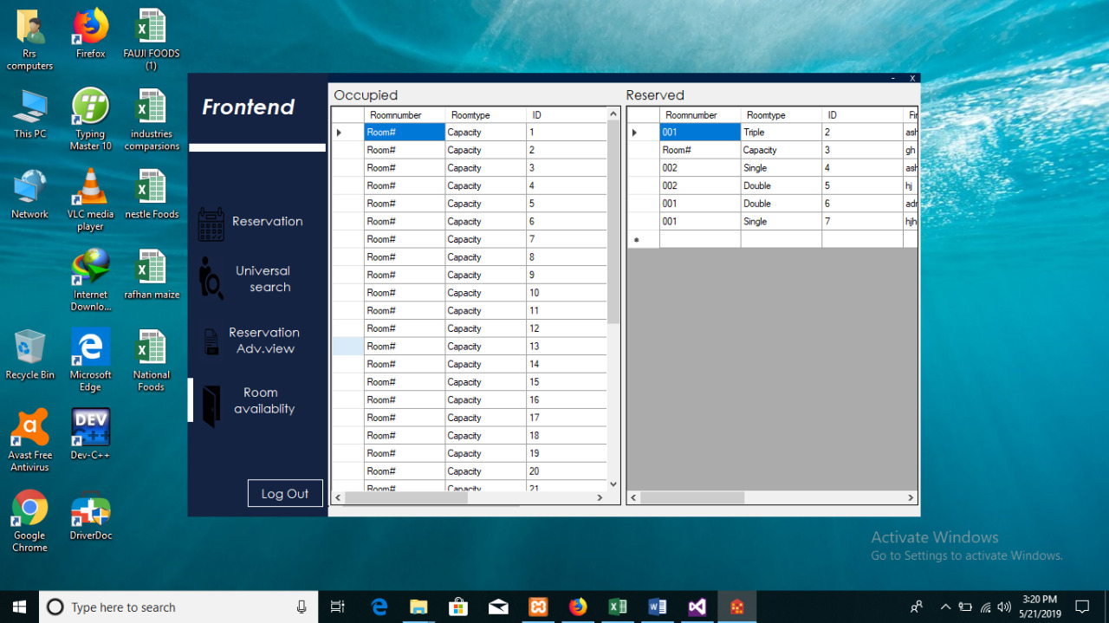

Slide 15
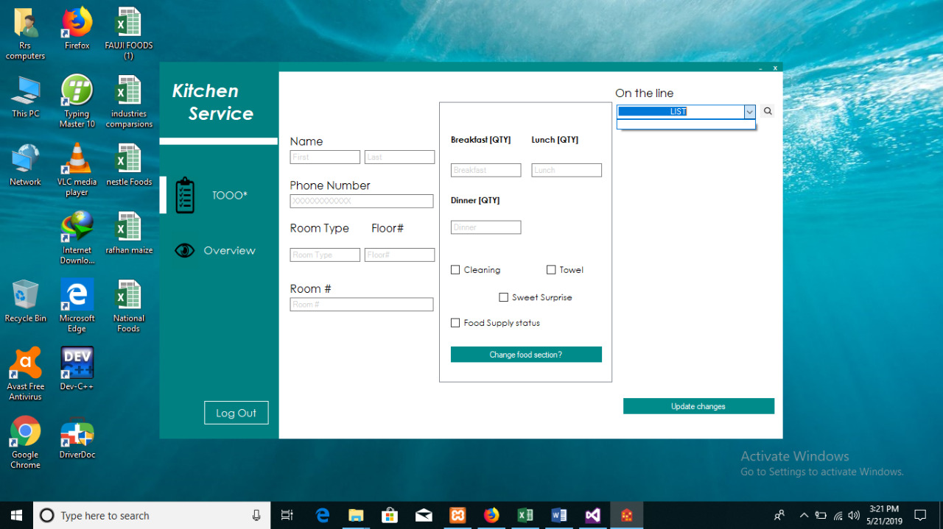

Slide 16
FUTURE SCOPE OF OUR PROJECT
The system will cover; Registration, meals, and accounts details.
Moreover, our program is efficiently handled by the system. To help the system smoothly carry out its intended purpose to meet the hotel management needs:

Slide 17

CONCLUSION
This project is designed to meet the requirements of Online Hotel Management. It has been developed in VB keeping in mind the specifications of the system. Overall the project teaches us the essential skills like
♣ Using system analysis and design techniques like GUI and its tools
♣ Understanding the database handling and query processing.

Slide 18
REFERENCES
https://youtu.be/vrmE98BGVdw
https://youtu.be/pmzLP2MLtTs
https://youtu.be/nLfzH4xOVqo
https://youtu.be/DFjYhemKpXI

Slide 19

Any Questions ?

Slide 20

Thank You

